Slide 1

Transforming Undergraduate STEM Education
Kerry Brenner
Board on Science Education
National Academies of Science, Engineering, and Medicine
Anne Egger
Central Washington University and
National Association of Geoscience Teachers
Archie Holmes
Executive Vice Chancellor
University of Texas System
February 20, 2026
Faculty Advisory Council IHBE

Slide 2



Acknowledgments
We’d also like to thank…
Commissioned papers authors
Invited experts participated in public meetings and conference presentations
Committee on Equitable and Effective Teaching in Undergraduate STEM Education: A Framework for Institutions, Educators and Disciplines
Staff of the Division of Behavioral and Social Sciences and Education (DBASSE) and in particular the Board on Science Education (BOSE)

Slide 3





The National Academies (NASEM)
A non-governmental organization (NGO)
Founded in 1863
Bring together committees of experts in all areas of scientific and technological endeavor
Address critical national issues and give advice to the federal government and the nation
NATIONAL ACADEMY OF MEDICINE
Notes:
Kerry
Talk about committees of volunteers

Slide 4
Board on Science Education Mission
Provide evidence-based guidance for practice and policy
Identify future directions for research
Serve as a connection point between research, policy and practice
Research
Policy
Practice
Notes:
Kerry

Slide 5
Overview of the Charge to the Committee
Develop a framework that articulates approaches to and guidelines for evidence-based, inclusive teaching.
Base framework on examination of evidence, including successful efforts to improve and support instruction.
Consider different modes of teaching (e.g., in-person, online, blended and hybrid teaching).
Consider different educational contexts (e.g., 2-year colleges, hybrid programs, research institutions).
Consider the roles that technology does, or can in the future, play in supporting equitable and effective teaching.
Identify policies and practices at the departmental, programmatic, and institutional levels that can facilitate implementation of the principles in the framework.
Examine the institutional infrastructure, policies, and practices needed to encourage and support evidence-based, equitable teaching, such as opportunities for professional development, faculty evaluation policies and practices, and reward and advancement systems.
Discuss the experiences and training opportunities graduate students and postdoctoral students will need in order to be prepared to employ equitable and effective instruction as future faculty members.
Provide actionable recommendations for institutions, disciplinary societies, funders, and policy makers on steps that could support implementation of the framework.
Call out areas in need of further research.

Slide 6
Scope of the Study
The committee was inclusive in considering the disciplines of STEM, types of post-secondary institutions, variety of instructors, and all students in their work.
We include students preparing for careers in fields heavily dependent on STEM knowledge and skills (such as nurses, medical doctors and technicians, biotech workers, scientists, mathematicians, and engineers), as well as those who are taking a course to satisfy a distribution requirement or learn about an interesting topic.
We include full-time and part-time roles, permanent and contingent employees, adjunct instructors, visiting professors, graduate teaching assistants, and tenured and tenure-track faculty, among others. We make use of the acronym VITAL to denote visiting faculty, instructors, teaching assistants, adjunct faculty, and lecturers.
Notes:
Throughout the report, we refer both to issues that are STEM-wide and to those that are discipline-specific or more prominent in some disciplines. Similarly, we provide examples of successful strategies and approaches that emerge from specific disciplines, many of which can be applied in others.
Regardless of whether their STEM courses contribute directly to individuals’ careers, the knowledge and skills gained have the potential to prepare all students to be knowledgeable and informed participants in their communities and societies, especially as science and technology plays an ever-increasing role in our lives.

Slide 7
Important Tenets
Transforming the undergraduate STEM education system requires two things:
Providing all students with the support they need to succeed, as measured by achievement of clearly communicated learning objectives.
Supporting and rewarding all instructors by providing them with the resources they need to successfully educate all of their students.
When these two things exist, we can expect transformation. In particular:
All students will learn and understand STEM concepts and be able to use them in practical ways.
Most, if not all, students will have the opportunities and the resources to demonstrate their learning by meeting the desired learning objectives.
Excellence cannot be achieved if demographic factors are predictive of academic achievement.
Notes:
Also talk here about continuous improvements. Emphasize the journey to equitable and effective teaching and how reflection and continuous improvement are key.
Throughout the report, we refer both to issues that are STEM-wide and to those that are discipline-specific or more prominent in some disciplines. Similarly, we provide examples of successful strategies and approaches that emerge from specific disciplines, many of which can be applied in others.
Regardless of whether their STEM courses contribute directly to individuals’ careers, the knowledge and skills gained have the potential to prepare all students to be knowledgeable and informed participants in their communities and societies, especially as science and technology plays an ever-increasing role in our lives.

Slide 8

Table of Contents
Chapter 1: Introduction
Chapter 2: Institutional Context of Post-Secondary STEM Education
Chapter 3: Understanding Teaching, Learning, and Equity
Chapter 4: Principles for Equitable and Effective Teaching of Undergraduate STEM Education
Chapter 5: Using the Principles to Improve Learning Experiences
Chapter 6: Role of Academic Units in Achieving Equitable and Effective Teaching
Chapter 7: Student Pathways through Undergraduate STEM Curricula
Chapter 8: Supporting Equitable and Effective Teaching Through Ongoing Professional Learning and Development
Chapter 9: Role of the Institution in Creating Equitable and Effective Learning Environments
Chapter 10: Recommendations for Current Action and Future Research
Setting the
scene
Resources available and in development
Notes:
These are the chapters of the final report. First I want to highlight that chapter 4, the principles, is the bulk of what went out for public comment in the discussion draft released in December 2023.
In the final report, Chapters 2 and 3 along with the introduction in Chapter 1 provide the context for the principles and their use by describing what we know about the current landscape of undergraduate STEM education and what we know about teaching, learning and equity; Chapters 5 describe how the principles can inform teaching practices, and chapters 6 through 9 discuss all of those policies and practices from the charge - the other factors that influence the capacity, motivation, and ability of instructors to implement changes in their teaching. I’ll outline the main points and conclusions from each chapter so I won’t spend more time describing them here.

Slide 9
Chapters 1–3: Setting the Stage
Many longstanding policies and practices in undergraduate STEM education have produced, perpetuated, and exacerbated differences in opportunities, experiences and outcomes.
Learning in STEM involves complex processes that are shaped by identities, experiences, and backgrounds, social interactions, and cultural context.
Widespread use of teaching strategies that are not supported by research have contributed to disparities in opportunity and outcomes for undergraduate STEM students.
Instructional practices that take students’ interests and experiences into account and empower them with authentic opportunities to engage with disciplinary content, practices, and analysis are more effective
Who are (STEM) students and STEM instructors?
What institutions do (STEM) students attend and how are institutions funded?
What we know about teaching, learning, and equity
Learning is complex and well-studied
Specific issues in the disciplines
Evidence of inequities
Existing efforts that promote equity
Notes:
Context chapter –
Committee took a broad view of STEM students, including those intending to major in the STEM fields as well as those enrolled in general education courses, certificate programs, and career and technical education. Statistics here are sometimes available only for undergraduates, not necessarily STEM.
Range of institutions and their missions
Broad view of the instructional workforce to include tenured and tenure-track faculty as well as VITAL instructors: Visiting faculty , instructors, Teaching Assistants, Adjuncts, and Lecturers
The sources of funding, particularly for public institutions, influences their capacity
The history that established systemic inequity and led to the current state of affairs
Chapter 3 lays the research foundation for the principles, first by focusing on the extent of what we know about the learning, then applying those well-studied pieces to specific issues within the STEM disciplines. We then describe the substantial evidence for inequity in STEM education. This chapter ends with an important acknowledgement of all of the work by others in moving towards a more equitable STEM education system.

Slide 10
Chapter 4: Principles for Equitable and Effective Teaching of Undergraduate STEM Education
STEM learning involves affective and social dimensions
Identity and sense of belonging shape STEM teaching and learning
Multiple forms of data can provide evidence to inform improvement
Flexibility and responsiveness to situational and contextual factors support student learning
Intentionality and transparency create more equitable opportunities
Students need opportunities to actively engage in disciplinary learning
Students’ diverse interests, goals, knowledge, and experiences can be leveraged to enhance learning
Notes:
These are the principles. Pause here for you to read them. This chapter includes the research behind each of the principles, and I suspect that many in this audience are aware of that evidence, or at least aware that the research exists. This is not true for everyone that we will be presenting to.

Slide 11
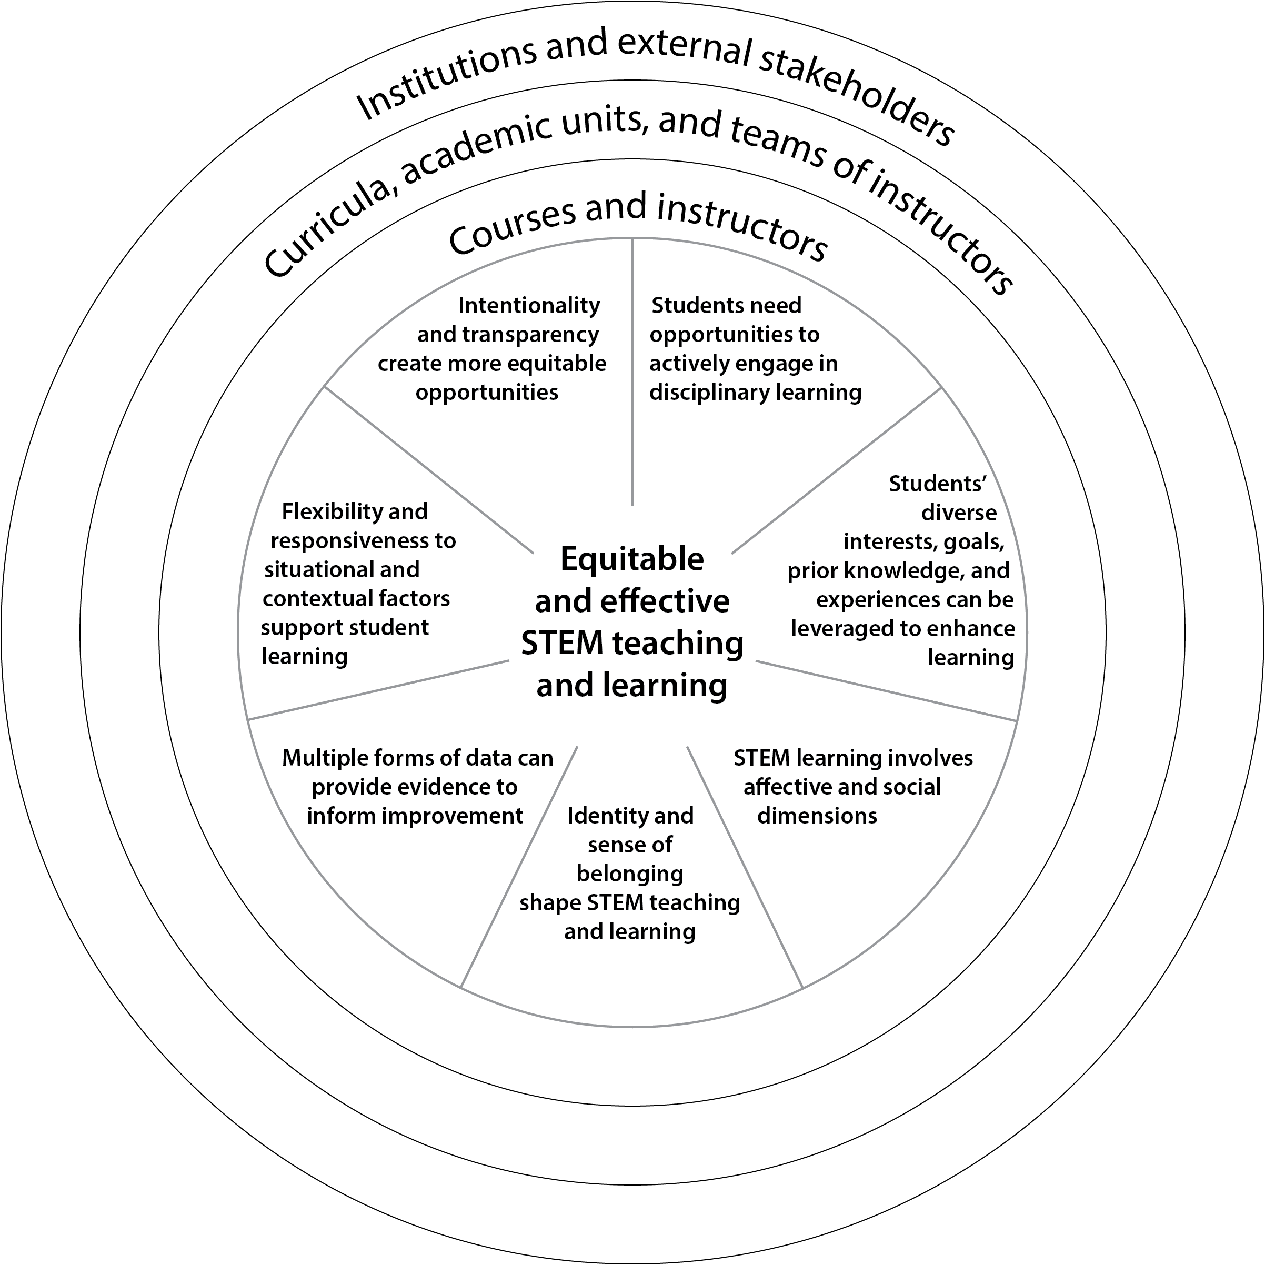
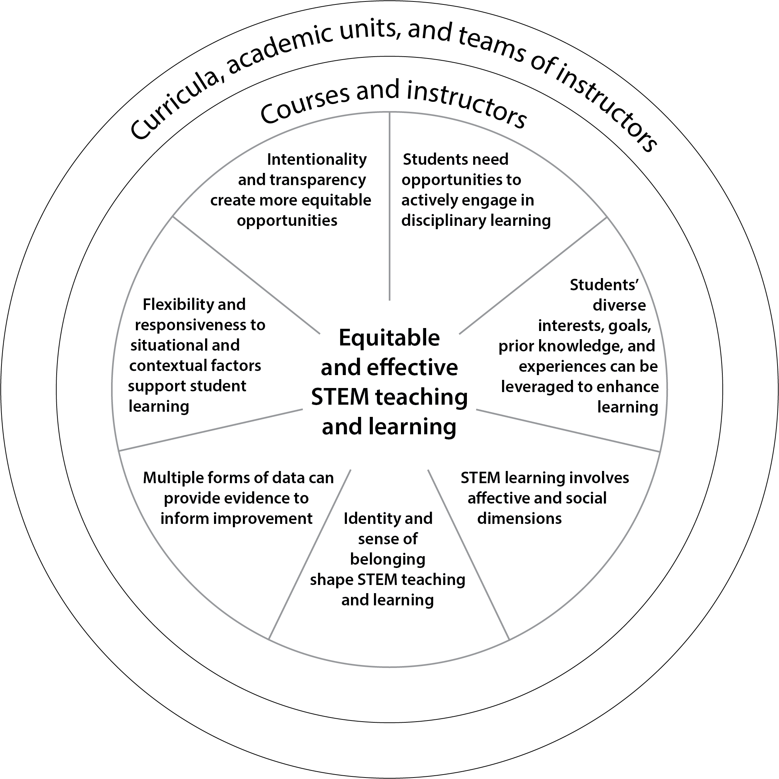
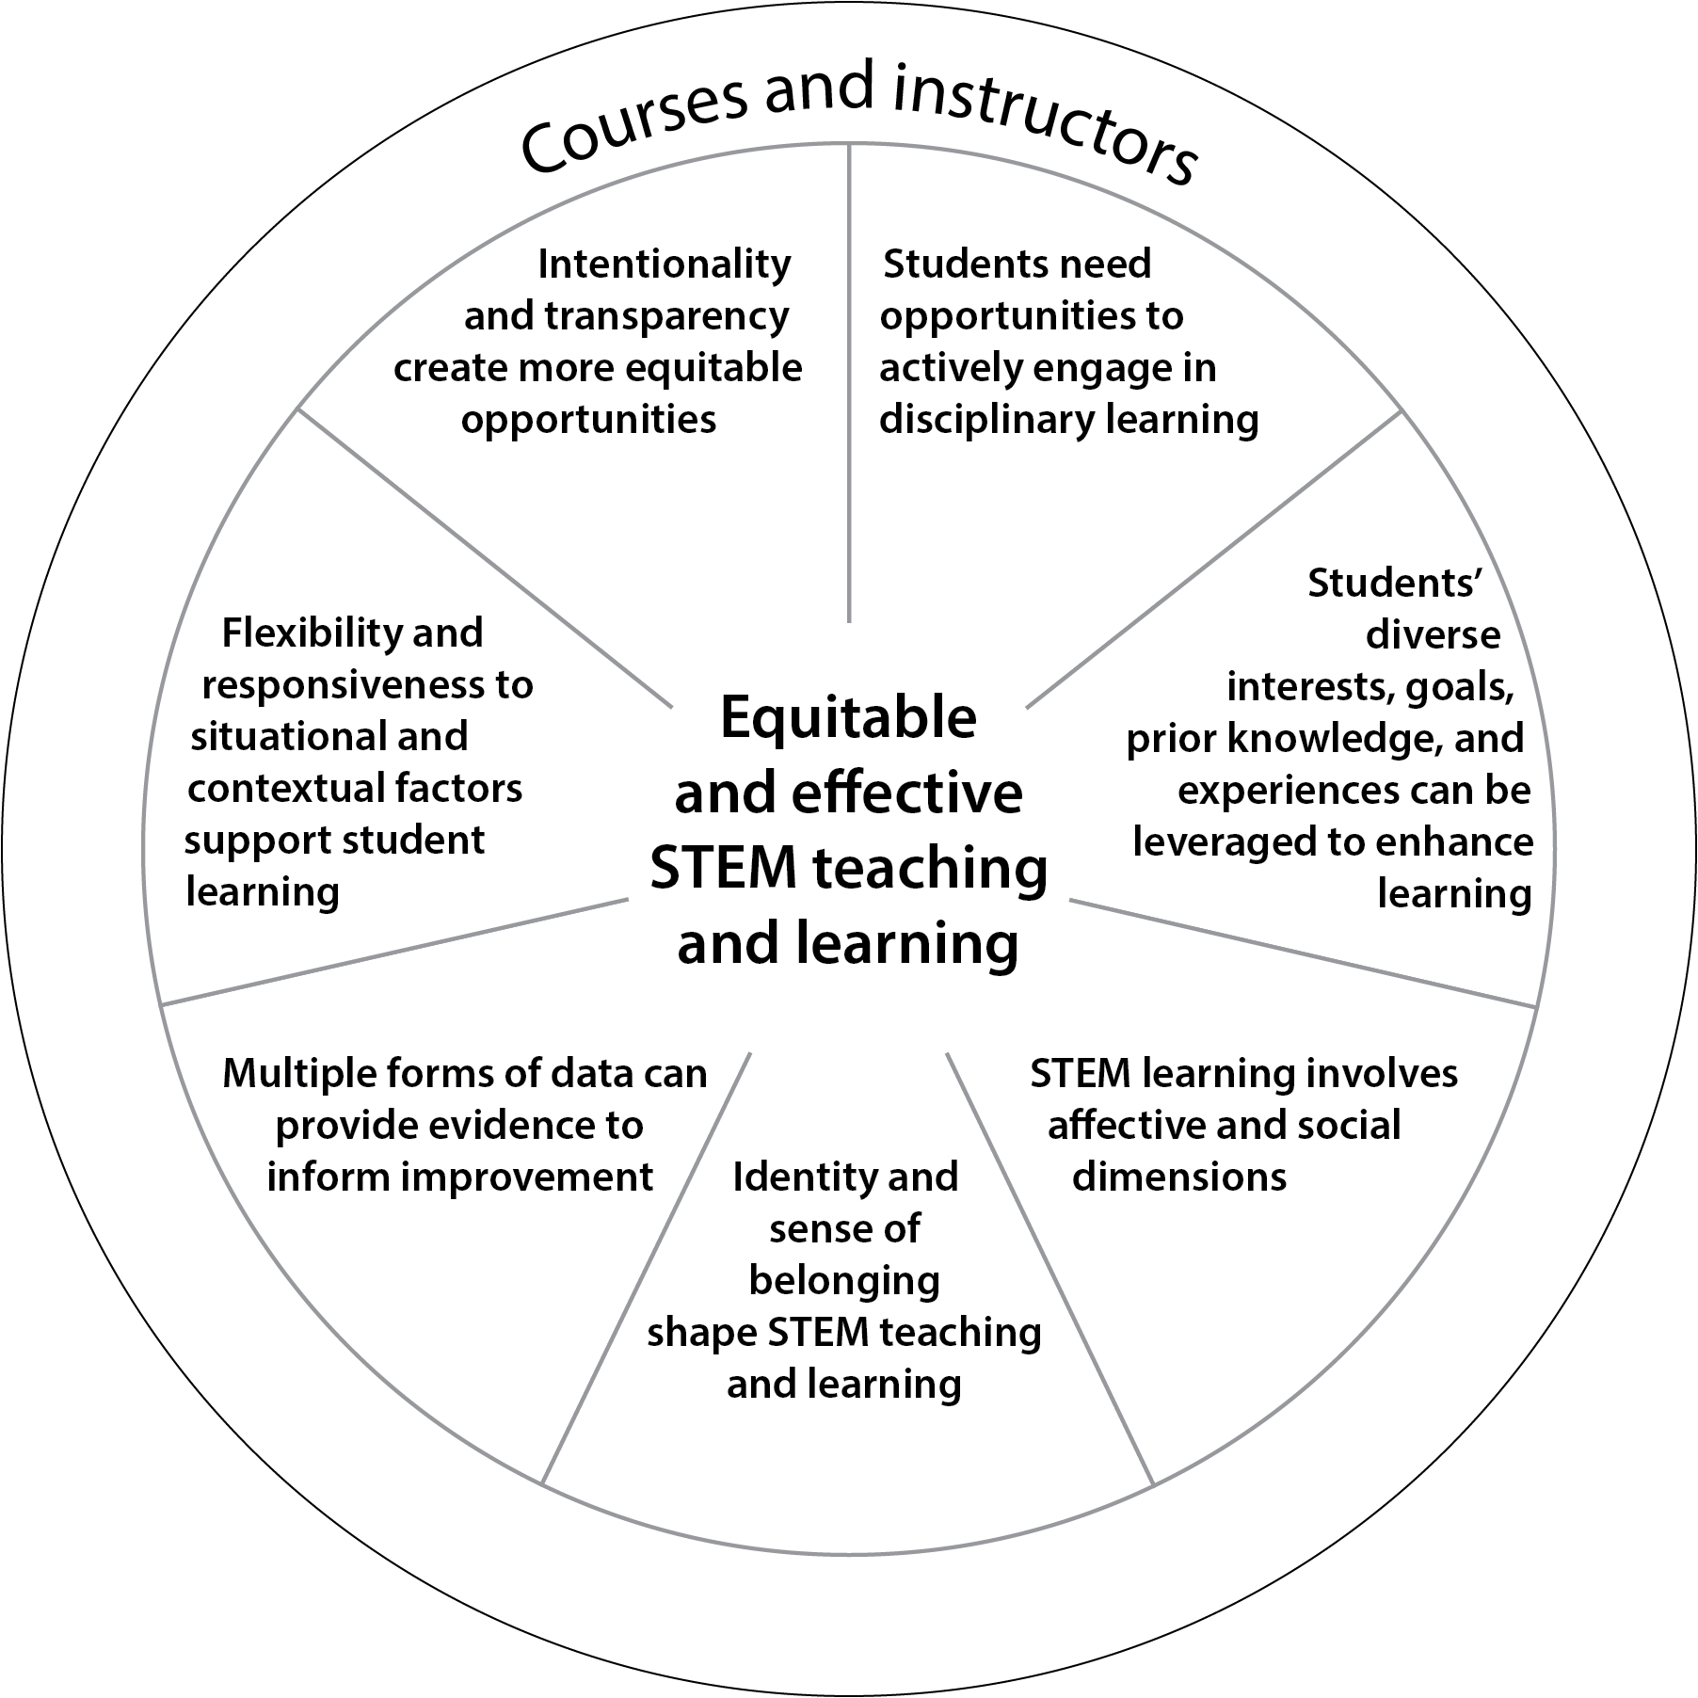
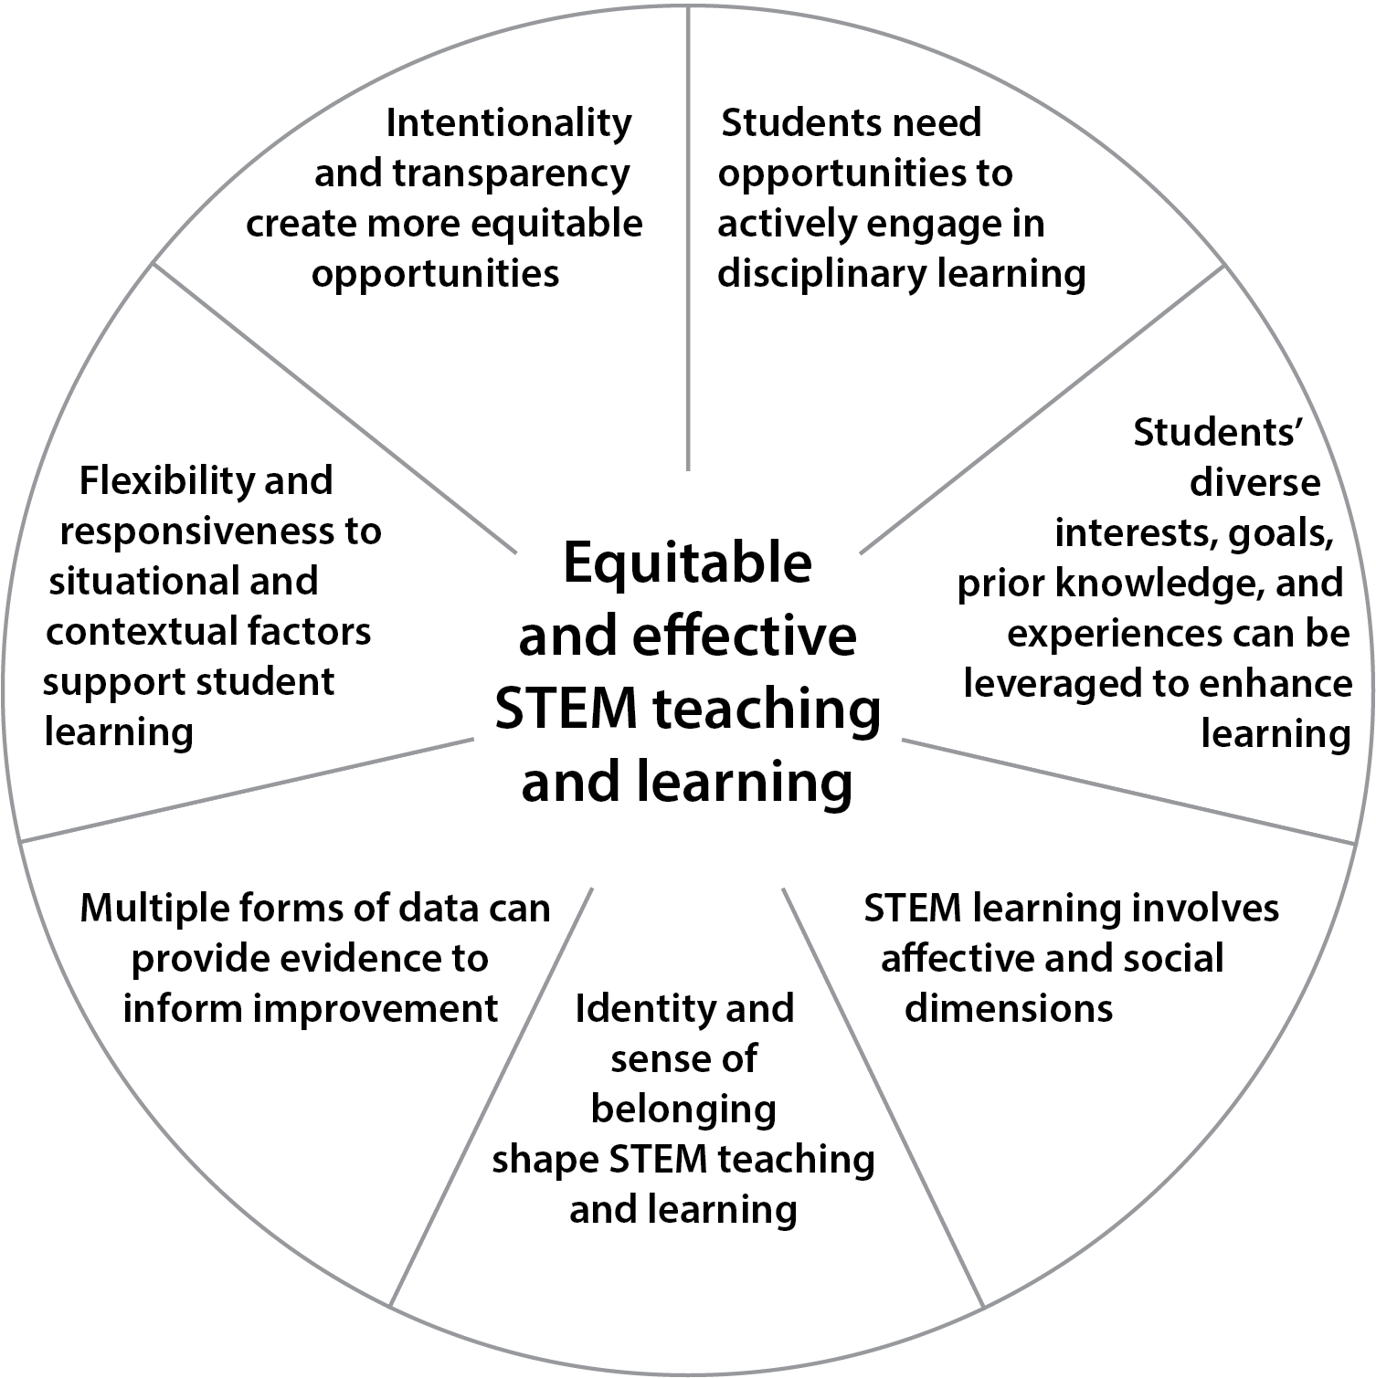
Chapters 8 & 9
Chapter 5
Chapters 6 & 7

Slide 12
Chapter 5: Using the Principles to Improve Learning Experiences
More of… | Less of…
Clear articulation of learning goals and how the work done in the course will help students achieve learning goals | A focus on getting through a set amount of content
Course structures that engage students as active learners | Course structures that maintain students as passive receivers of information
Activities that regularly engage students in using the skills and knowledge of the discipline | Separate laboratory sections focused on skills without clear connections to course content
Being transparent about opportunities and expectations for learning and engagement | Assuming that all students are aware of what they “should” be doing
Grading practices that allow for formative feedback and focus on mastery | Grading practices that focus on a theoretical distribution (a curve) and promote competition in a few high-stakes assessments
Table 5.1
Notes:
Chapter 5 is focused on instructional practices, and describes an important subset of the specific practices

Slide 13
Chapter 6: Role of Academic Units in Achieving Equitable and Effective Teaching
Students are often expected to take multiple STEM courses, but the connections between the courses are often not well coordinated, and the overall goals for what students will learn across the courses are not always well articulated.
Academic units hold collective responsibility for all learning experiences they oversee and can improve the coherence of learning goals across course sequences, programs, and majors.
Academic units play a major role in decisions and policies about teaching, including how teaching is valued, recognized, evaluated, and rewarded.
Oversee teaching
Intended-enacted-experienced (and hidden) curriculum
Academic and disciplinary culture
Program learning outcomes
Foundational courses and coordinating across departments
Valuing and evaluating teaching
Notes:
Chapter 6 moves up a level to the “academic unit,” which is, in many but not all cases a department. The unit has control over a variety of important components of the student learning experience, however, including….
In this chapter, we lay out the distinction between the intended, enacted, experienced, and hidden curriculum.

Slide 14
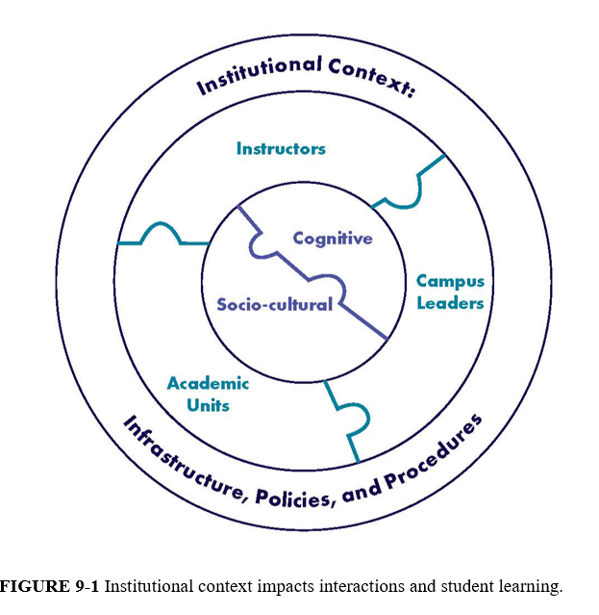
Chapter 9: Role of the Institution in Creating Equitable and Effective Learning Environments
Institutional change is an ongoing process of continuous improvement that can include
opportunities to become familiar with goals and principles of change;
recognition of an academic unit’s culture;
attention to power dynamics in the institution; and
communication among key stakeholders.
Data, both aggregated and disaggregated, are a key tool to understand, enact, and monitor change.
Both quantitative and qualitative data are needed to fully understand what is happening in a system and to provide information to guide change efforts.
Reflective analysis of data best guides policy and practice decisions and informs ongoing efforts at improvement.
Figure 9.1
Notes:
Inner circle: All learning involves a dynamic interaction between cognitive and socio-cultural processes and the Principles address both.
Middle ring: Implementation of the Principles requires the integrated effort of individuals at multiple levels of the institution.
Outer ring: Implementation of the Principles also depends on acknowledging the needs and challenges of the particular institutional context. The institutional context also impacts interactions of students, instructors, academic units, and campus leaders (middle ring) in ways that influence student learning (both cognitive and socio-cultural) (inner circle).

Slide 15

Categories of Recommendations
Toward Equitable and Effective Learning Environments
Recommendations 1-3
Valuing and Supporting Instructors
Recommendations 4-10
Measuring and Advancing System Change
Recommendations 11-15
Notes:
We should emphasize how recommendations are structured and why they are important.

Slide 16
Toward Equitable and Effective Learning Environments
Main messages of Recommendations #1-3
Instructors should:
Use the Principles to reflect upon and guide teaching
Articulate clear learning goals and use them to design courses and assessments
Academic units should:
Review the collective impact and overall learning goals for all courses offered and use data to consider the student experience navigating those courses
Developers of instructional materials should
Work collaboratively with experts in teaching and learning (and experienced instructors)
Use the Principles as a guide for informing design from the initial stages of conceptualization

Slide 17
Valuing and Supporting Instructors
Main messages of Recommendations #4-10
Academic unit and institutional leaders should
Value instruction and support instructors for graduate students, post-docs, VITAL faculty, tenure-track, and tenured faculty
Ensure professional learning and development is encouraged, and rewarded for all instructors
Cultivate community around teaching
Use holistic approaches to teaching evaluation
Consider equitable and effective teaching during hiring and promotion
Graduate and postdoctoral program leaders should
Make preparation for teaching an integral learning goal of their programs
Support meaningful PLD activities focused on teaching, learning, course design, and creating an equitable learning environment that embraces and promotes equitable and effective teaching
Arrange for support by mentors with expertise using the Principles

Slide 18
Measuring and Advancing System Change
Main messages of Recommendations #11-15
Institutional leaders should use data for continuous improvement and support access to and use of data by all stakeholders
Academic units should consider their students and their experiences and address inequities and obstacles
Funders, oversight bodies, professional, academic, and disciplinary societies and organizations should publicly endorse and elevate the Principles for Equitable and Effective Teaching and adopt them to guide their work related to undergraduate education.

Slide 19

Resources to support the use of this report
The report itself: Can be downloaded for free as a complete report or by chapter
Summaries and reflection prompts: Available soon …
More…

Slide 20
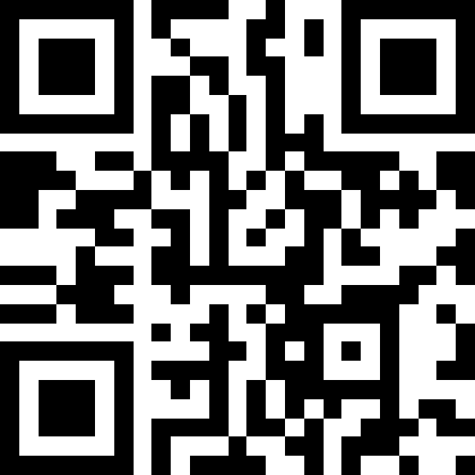
A Complementary Resource from NASEM
Modules to Support Systemic Change in Undergraduate STEM Education

Slide 21
Part I: Foundational ideas
Module 1: Using a systems view to improve undergraduate STEM education (Goals and purpose of the module collection)
Module 2: From Silos to Systems: Driving Change through an Ecosystems Approach
Module 3: Understanding STEM culture
Module 4: Student-ready institutions
Part II: Practical strategies for key audiences
Module 5: How institutional leaders can foster systemic change to improve undergrad STEM Ed
Module 6: How academic unit leaders can foster systemic change to improve undergrad STEM Ed
Module 7: How centers for teaching and learning can contribute to improving undergrad STEM Ed

Slide 22
Audiences and Uses of the Modules
Intended Audiences:
Presidents and Provosts
Deans and Department Chairs
Faculty Leaders
Possible Uses:
Develop ideas for institution-specific changes
Encourage discussion among institutional stakeholders
Highlight ideas, resources, and frameworks for systemic institutional change

Slide 23
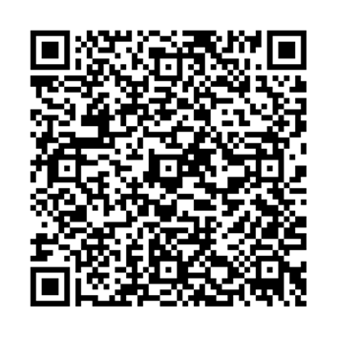
Thank you!
Questions?
The report can be read and downloaded for free from NASEM.
Use the URL or QR code to access the project page, which also has a highlights document and a link to an online interactive website.
https://nationalacademies.org/UG-STEM-Teaching

